Slide 1

NSG Pilkington – University of Liverpool Machine Learning Project: 14/07/2021
Dr. Peter Green
Diego Echeverria
Sarini Jayasinghe
Risk Institute,
School of Engineering

Slide 2
Today
Content:
MK4 and ISRA-5D pipelines
List of inputs used in all the analysis
Updated plots: Regression using the training dataset
Test data: Fault scanner data and Tag data PCA plots
The Front wall temperature signals that we are averaging
Upskilling:
Linear regression
How do we learn ‘online’?
What actually is a Neural Network?
What is a Gaussian Process?
How does PCA work?
Shannon Entropy

Slide 3
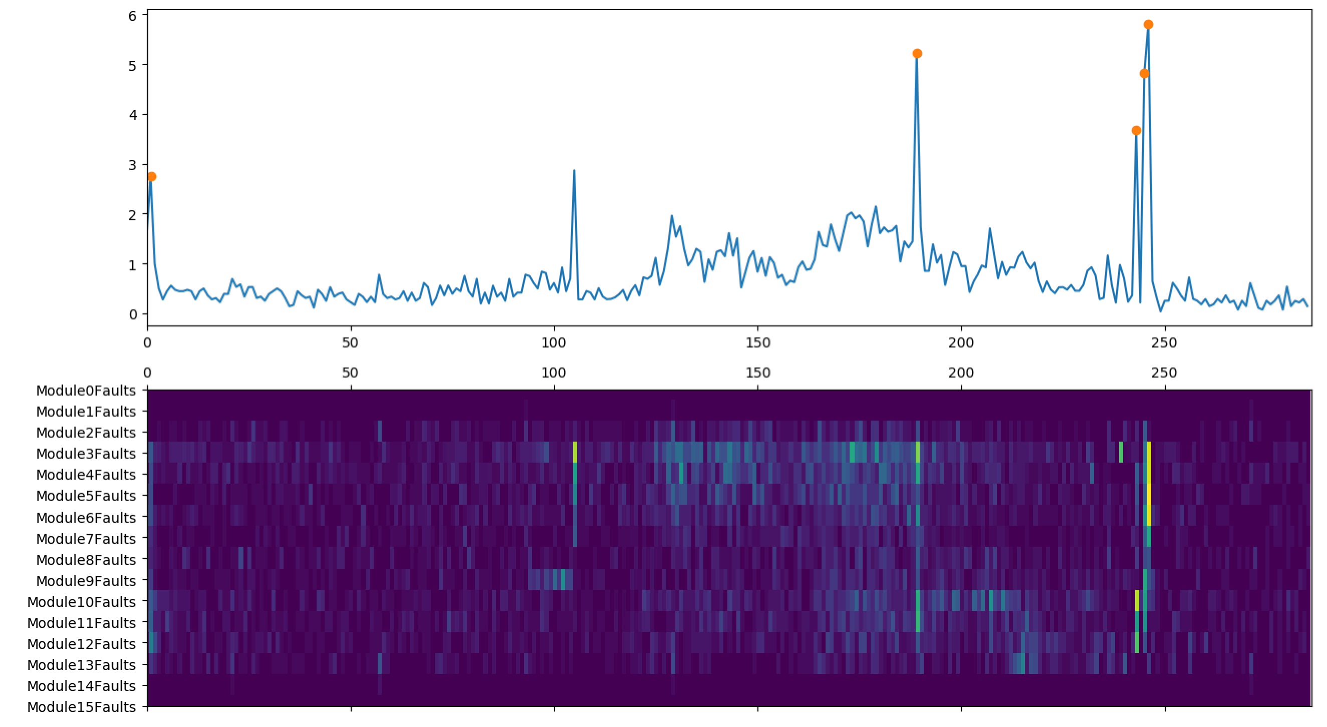
Data Processing Pipeline (MK4)
Isolate raw data between specified time period
Identify strip locations
(total faults > 2.5 and entropy > 2
Remove spikes
0
Low pass filter
1
High pass filter
Outlier definition
Faut density > 1 $σ$
Remove outliers

Slide 4
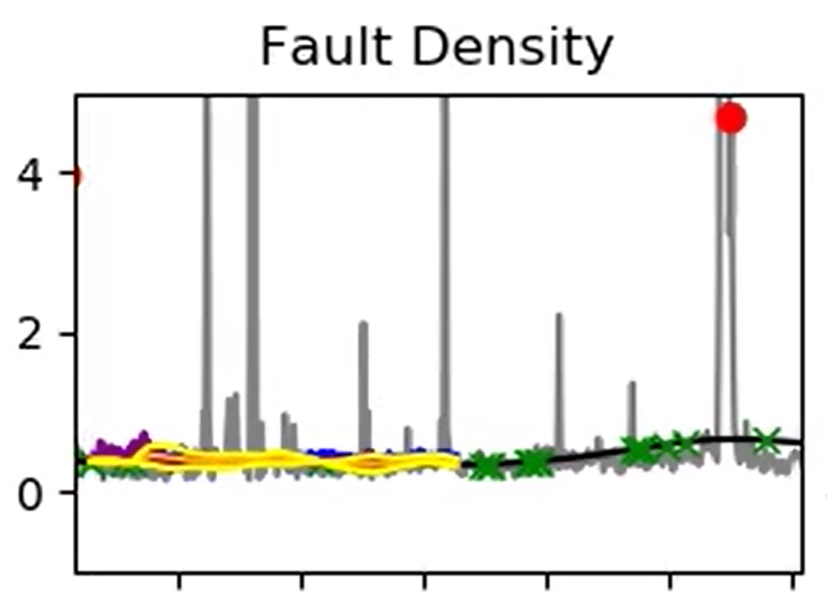
Data Processing Pipeline (MK4)
Isolate raw data between specified time period
Identify strip locations
(total faults > 2.5 and entropy > 2
Remove spikes
0
Low pass filter
1
High pass filter
Outlier definition
Faut density > 1 $σ$
Remove outliers
Model ignores stripes.
In the application of the Machine Learning regression models (outside of the pre-processing pipeline), we are ignoring the points identified with a stripe when assembling the training dataset.

Slide 5
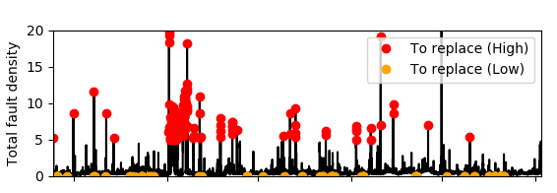
Data Processing Pipeline (ISRA-5D)
Isolate raw data between specified time period
0
Process fault density
1
Identify high furnace fault (ff > 5) and low furnace fault (ff < 0.05) values
Replace offending module data with the average of remaining modules at identified high fault density values
Replace low values with the previous reading

Slide 6
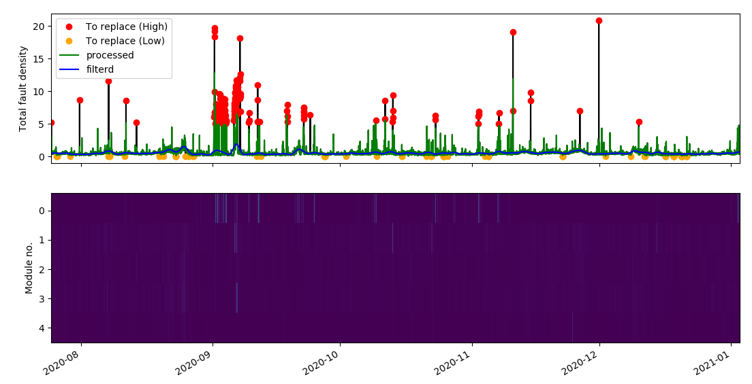
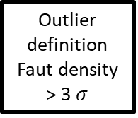
Data Processing Pipeline (ISRA-5D)
Remove spikes
0
Low pass filter
1
High pass filter
Outlier definition
Faut density > 3 $σ$
Remove outliers

Slide 7
Today
Content:
MK4 and ISRA-5D pipelines
List of inputs used in all the analysis
Updated plots: Regression using the training dataset
Test data: Fault scanner data and Tag data PCA plots
The Front wall temperature signals that we are averaging
Upskilling:
Linear regression
How do we learn ‘online’?
What actually is a Neural Network?
What is a Gaussian Process?
How does PCA work?
Shannon Entropy

Slide 8
List of inputs
The inputs listed below have been used in all the analysis shown in this presentation.
'Port 1 Combustion Air Flow (combined)',
'Port 2 - 3 Combustion Air Flow (combined)',
'Port 4 - 5 Combustion Air Flow (combined)',
'Port 6 - 7 Combustion Air Flow (combined)',
'Port 8 Combustion Air Flow (combined)',
'200000 Front Wall Temperature Average (PV)',
'Regenerator Crown Temperature Port 2 (abs. difference)',
'Regenerator Crown Temperature Port 4 (abs. difference)',
'Regenerator Crown Temperature Port 6 (abs. difference)',
'Regenerator Crown Temperature Port 8 (abs. difference)',
'Regenerator Base Temperature Port 1 (abs. difference)',
'Regenerator Base Temperature Port 2 (abs. difference)',
'Regenerator Base Temperature Port 3 (abs. difference)',
'Regenerator Base Temperature Port 4 (abs. difference)',
'Regenerator Base Temperature Port 5 (abs. difference)',
'Regenerator Base Temperature Port 6 (abs. difference)',
'Regenerator Base Temperature Port 7 (abs. difference)',
'Regenerator Base Temperature Port 8 (abs. difference)',
'10425 Calculated Cullet Ratio',
'1950 Canal Temp. Control Pyrometer (2)',
'10279 Canal Temp. Control (PV)',
'2922 Closed Bottom Temperature - Downstream Working End (PV)',
'2913 Closed Bottom Temperature - Port 1 (PV)',
'2918 Closed Bottom Temperature - Port 6 (PV)',
'2921 Closed Bottom Temperature - Upstream Working End (PV)',
'1650 Combustion Air Temperature Measurement’,
'10091 Furnace Load',
'15119 Furnace Pressure (PV)', '9393 Glass Level Control (OP)',
'7546 Open Crown Temperature - Port 1 (PV)',
'7746 Open Crown Temperature - Port 2 (PV)',
'7673 Open Crown Temperature - Port 5 (PV)',
'7483 Open Crown Temperature - Port 6 (PV)',
'10271 Open Crown Temperature - Upstream Refiner (PV)',
'7520 Open Crown Temperature - Upstream Working End (PV)',
'9400 Port 2 Gas Flow (SP)’,
'9282 Tweel Position',
'11384 Wobbe Index (Incoming Gas)'

Slide 9
List of inputs
Number of inputs = 38
Some combined inputs are correlated because we are not currently eliminating them according to the correlation analysis.
On the other hand, all the not combined inputs have been eliminated if they are correlated.

Slide 10
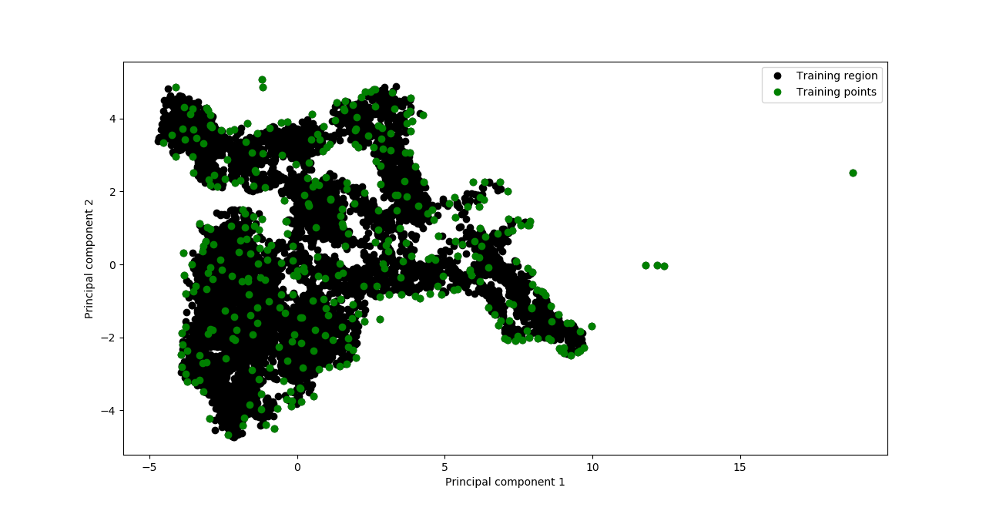
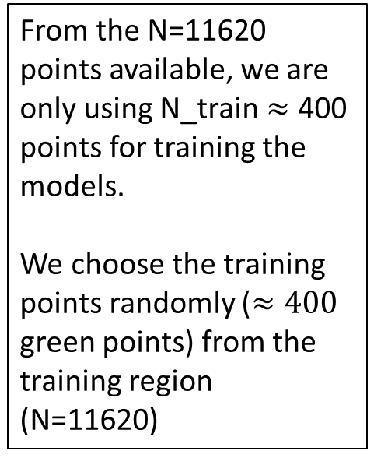
Inputs at training points
From the N=11620 points available, we are only using N_train $≈$ 400 points for training the models.
We choose the training points randomly ($≈400$ green points) from the training region (N=11620)

Slide 11
Inputs at training points
Each time we run an experiment (generate a video), a new set of training data is obtained.
This is why sometimes we see that the GP have identified 10 relevant, for one video, and 9 relevant inputs, for another video.

Slide 12
Today
Content:
MK4 and ISRA-5D pipelines
List of inputs used in all the analysis
Updated plots: Regression using the training dataset
Test data: Fault scanner data and Tag data PCA plots
The Front wall temperature signals that we are averaging
Upskilling:
Linear regression
How do we learn ‘online’?
What actually is a Neural Network?
What is a Gaussian Process?
How does PCA work?
Shannon Entropy

Slide 13
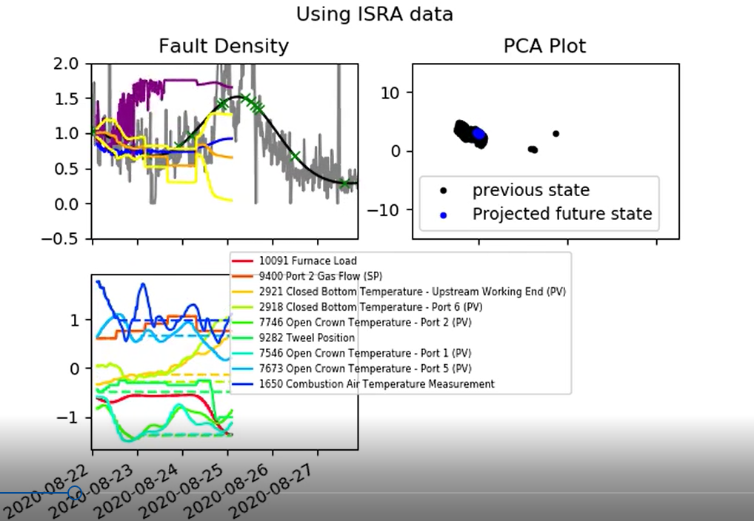
ISRA 5D
Plot indicating fault density predictions made using ISRA scanner. The video will be uploaded to SharePoint `ISRA training’
Y-axis limits changed

Slide 14
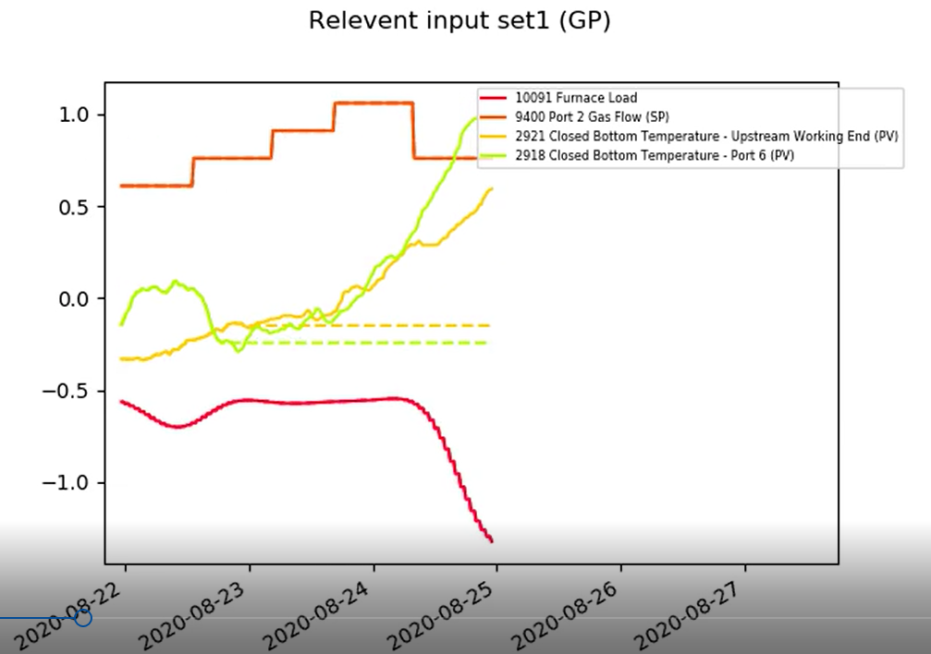
ISRA 5D
Plot indicating GP highest relevant inputs (first 4).
The video will be uploaded to SharePoint `ISRA training relevant input set1 (GP)’

Slide 15
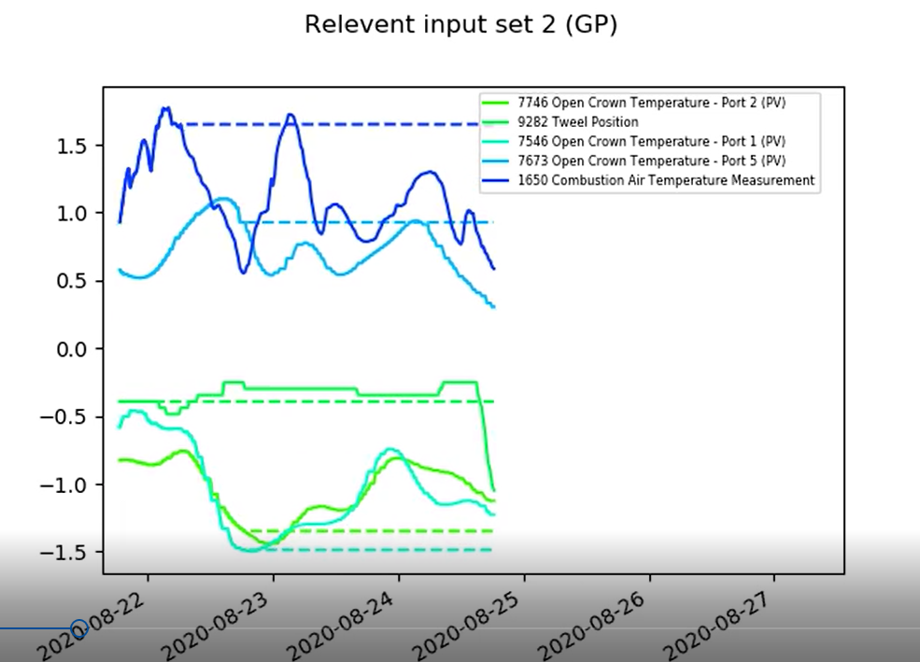
ISRA 5D
Plot indicating GP highest relevant inputs (second 5). The video
will be uploaded to SharePoint `ISRA training relevant input set2 (GP)’

Slide 16
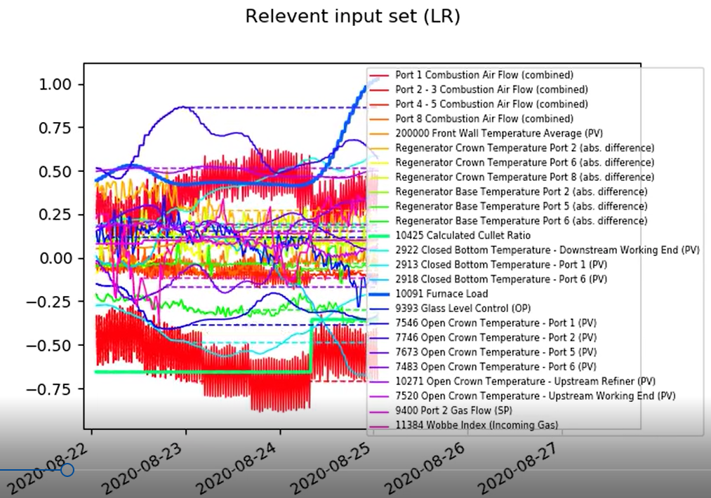
ISRA 5D
Plot indicating LR highest relevant inputs.
The video will be uploaded to SharePoint `ISRA training relevant input set (LR)’

Slide 17
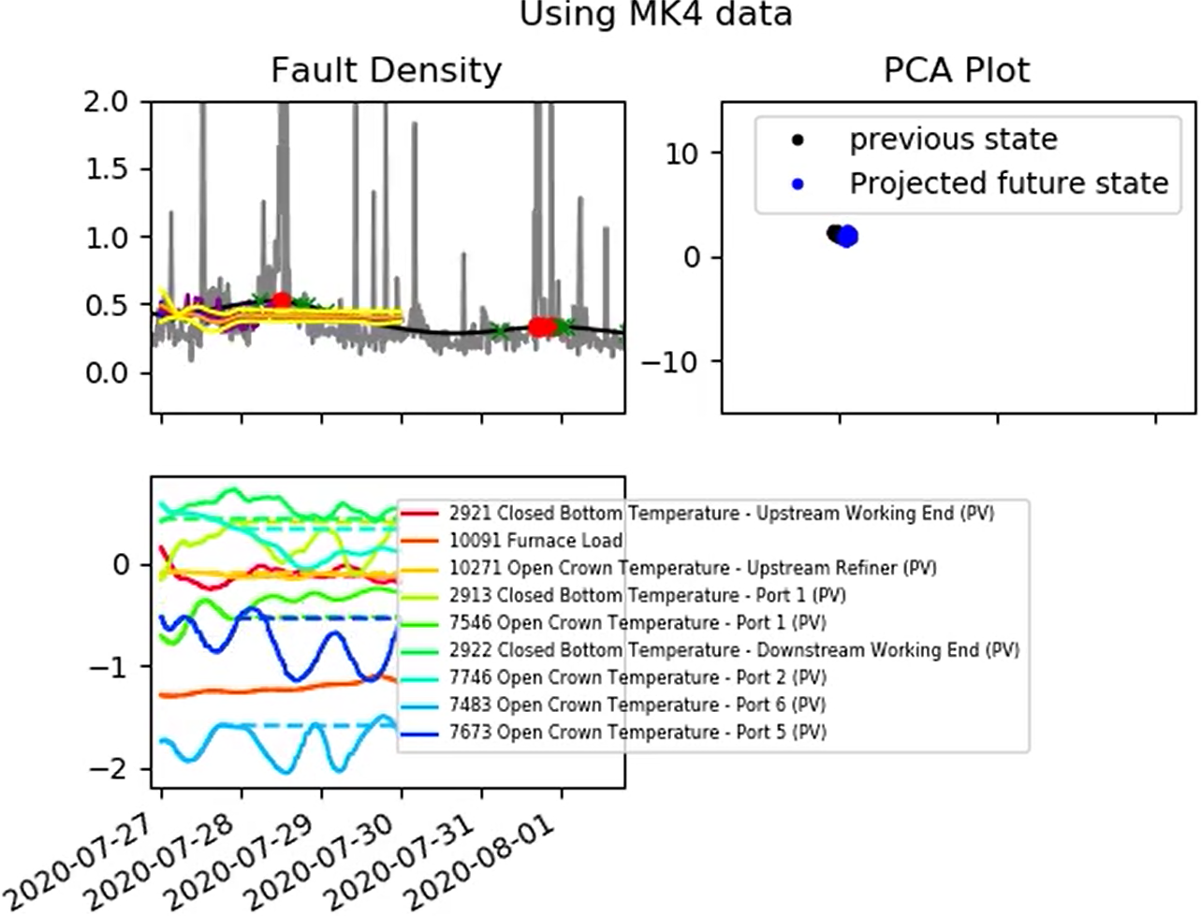
MK4 Data
Plot indicating fault density predictions made using MK4 scanner. The video will be uploaded to SharePoint `MK4 training’

Slide 18
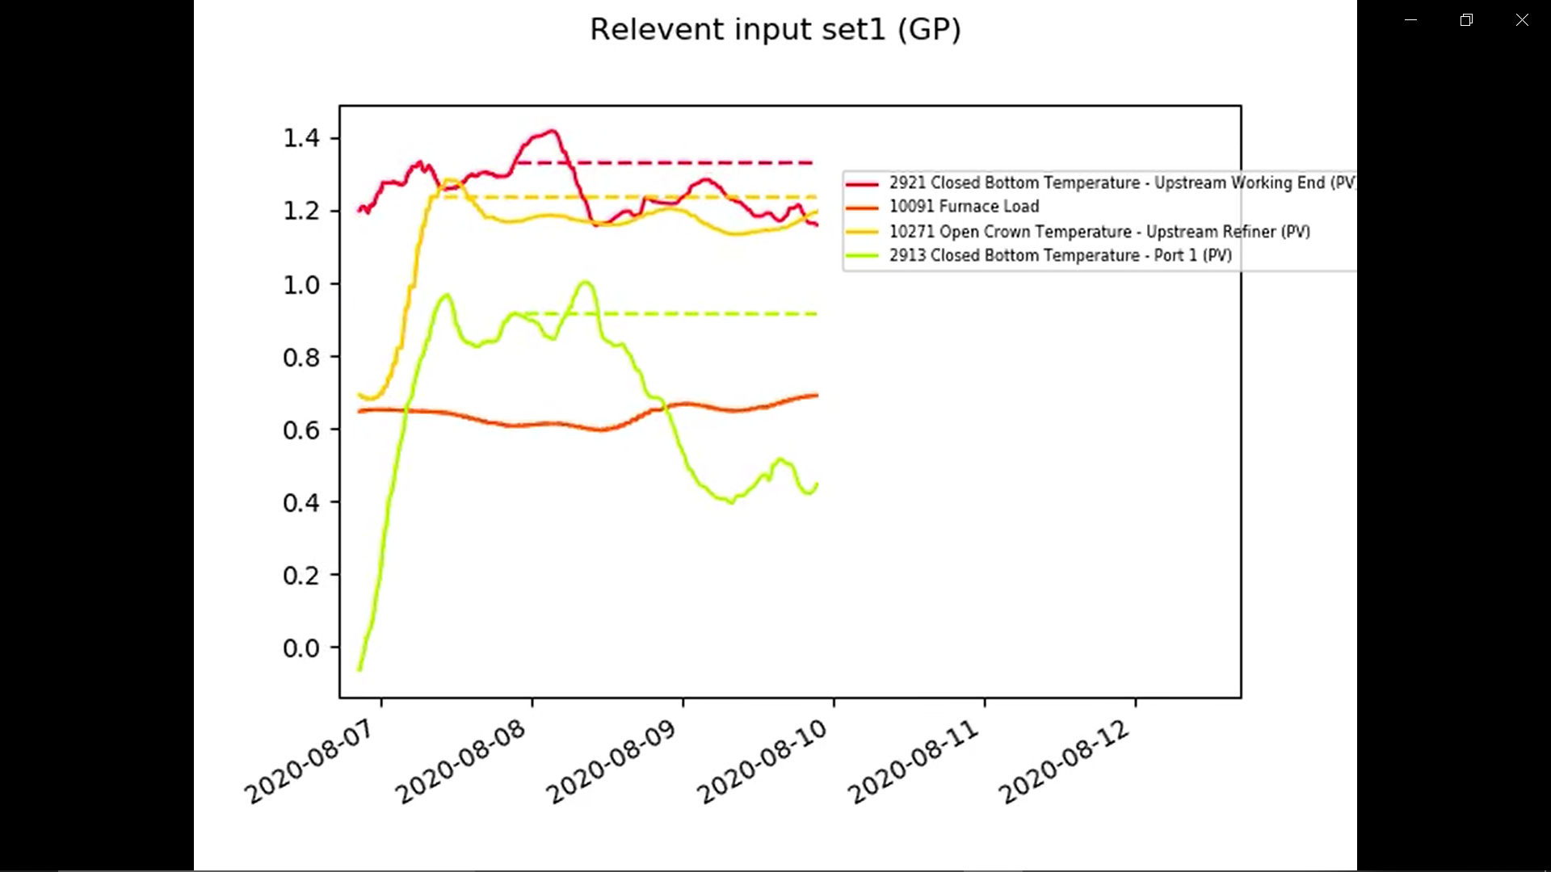
MK4 Data
Plot indicating GP highest relevant inputs (first 4).
The video will be uploaded to SharePoint `MK4 training relevant input set1 (GP)’

Slide 19
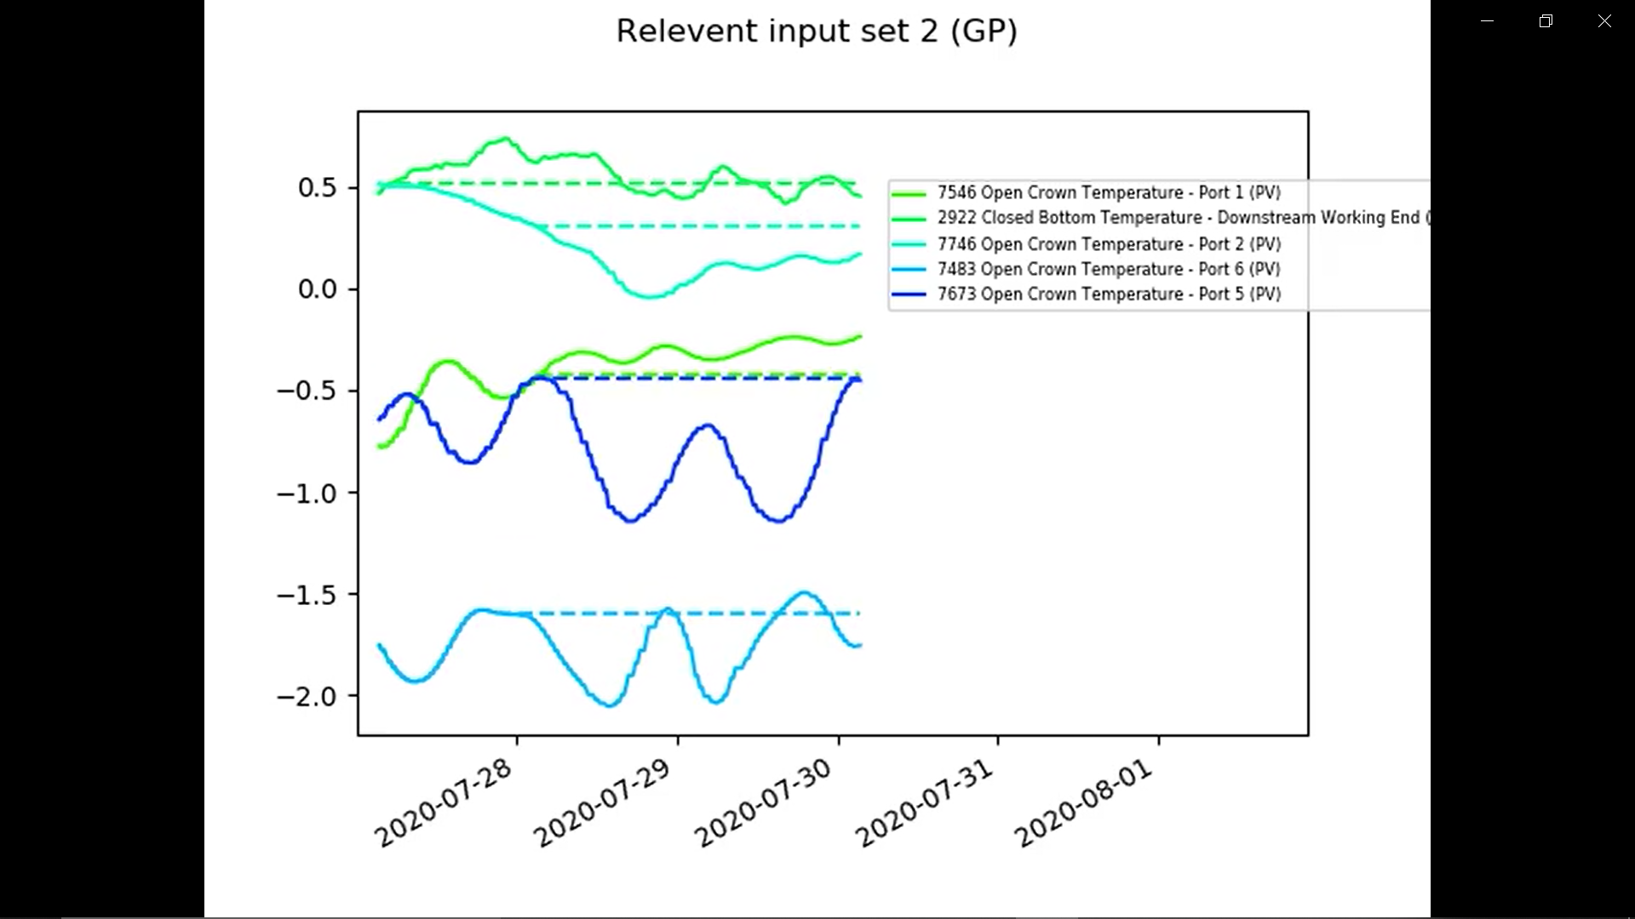
MK4 Data
Plot indicating GP highest relevant inputs (second 5). The video
will be uploaded to SharePoint `MK4 training relevant input set2 (GP)’

Slide 20
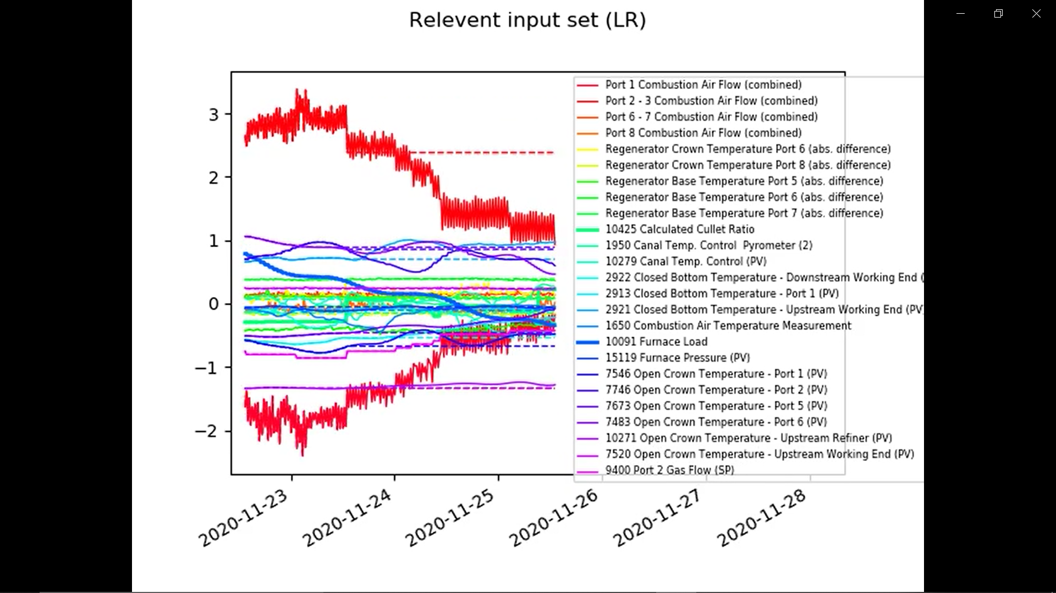
Linear Regression plot: Inputs x $θ$
Plot indicating LR highest relevant inputs.
The video will be uploaded to SharePoint `MK4 training relevant input set (LR)’

Slide 21
Linear Regression plot: Inputs x $θ$
We are currently using all the combined inputs. They have not been eliminated accordingly to the correlation analysis.
The GP can identify the correlated inputs and automatically choose one.
The LR model doesn't have this feature.

Slide 22
Videos uploaded to the sharepoint
MK4:
MK4 training.mp4
MK4 training Relevant input set 1 (GP).mp4
MK4 training Relevant input set 2 (GP).mp4
MK4 training Relevant input set (LR).mp4
ISRA-5D:
ISRA training.mp4
ISRA training Relevant input set 1 (GP).mp4
ISRA training Relevant input set 2 (GP).mp4
ISRA training Relevant input set (LR).mp4

Slide 23
Today
Content:
MK4 and ISRA-5D pipelines
List of inputs used in all the analysis
Updated plots: Regression using the training dataset
Test data: Fault scanner data and Tag data PCA plots
The Front wall temperature signals that we are averaging
Upskilling:
Linear regression
How do we learn ‘online’?
What actually is a Neural Network?
What is a Gaussian Process?
How does PCA work?
Shannon Entropy

Slide 24
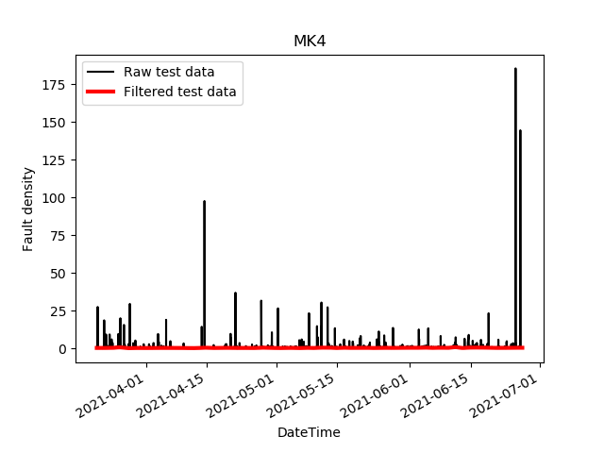
Test data: MK4

Slide 25
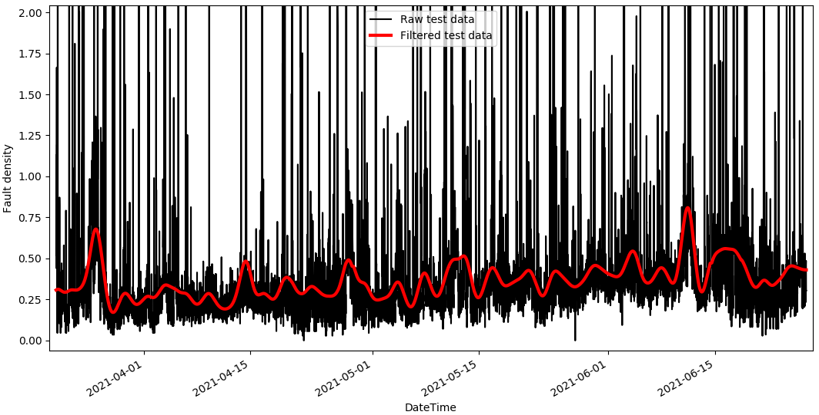
Test data: MK4
Zoomed in view

Slide 26
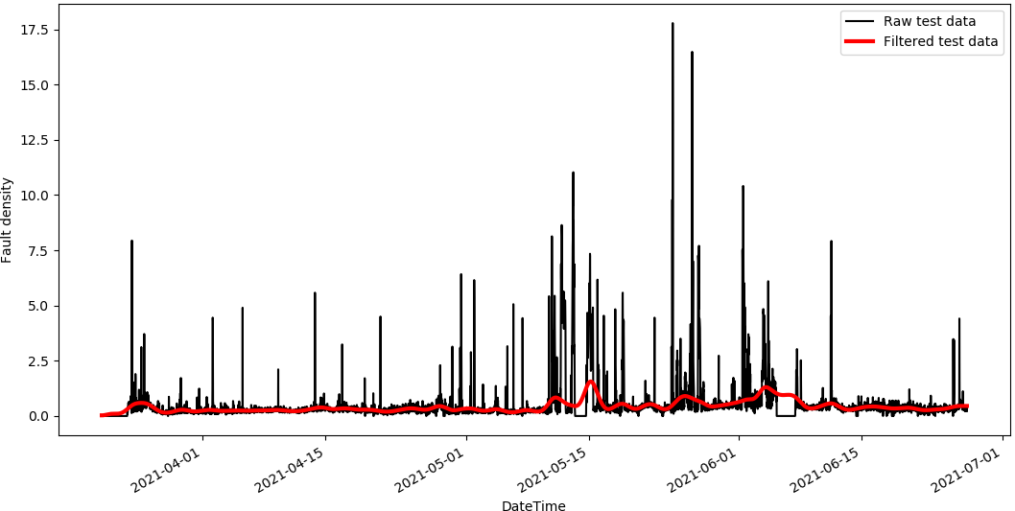
Test data: ISRA-5D

Slide 27
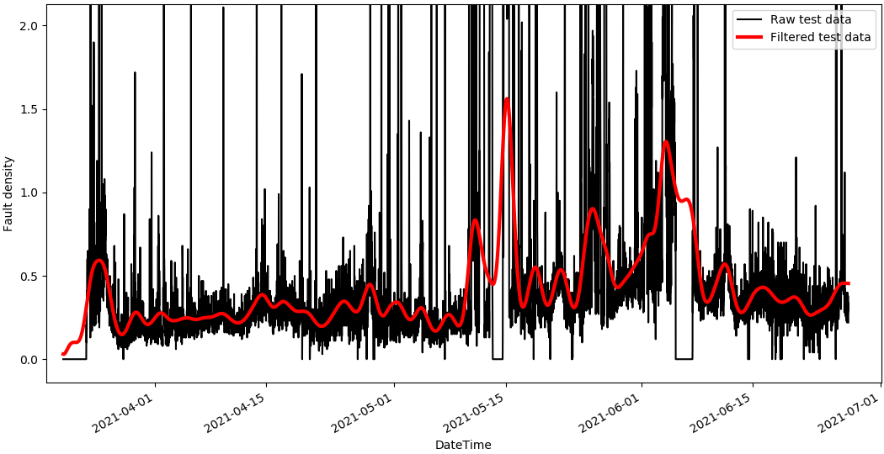
Test data: ISRA-5D
Zoomed in view

Slide 28
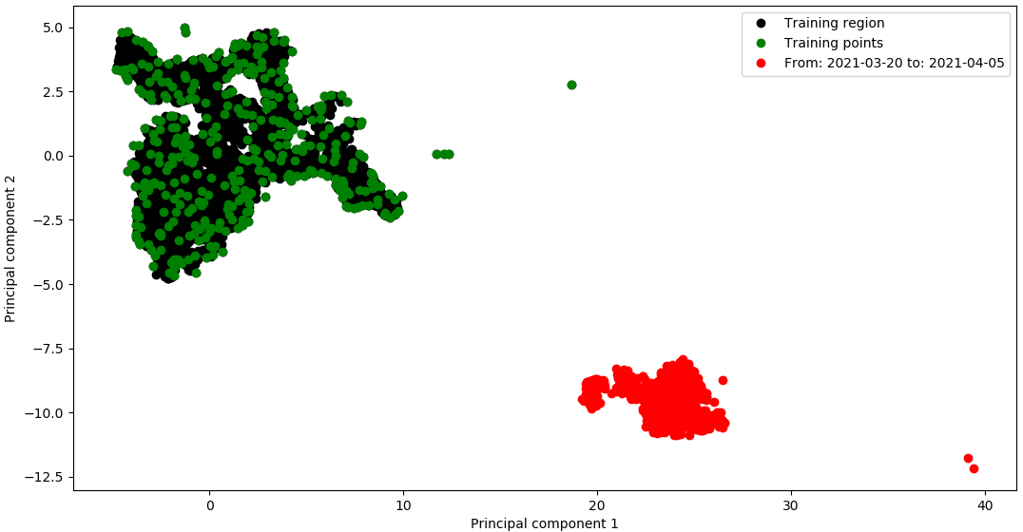
Test data: PCA tag data

Slide 29
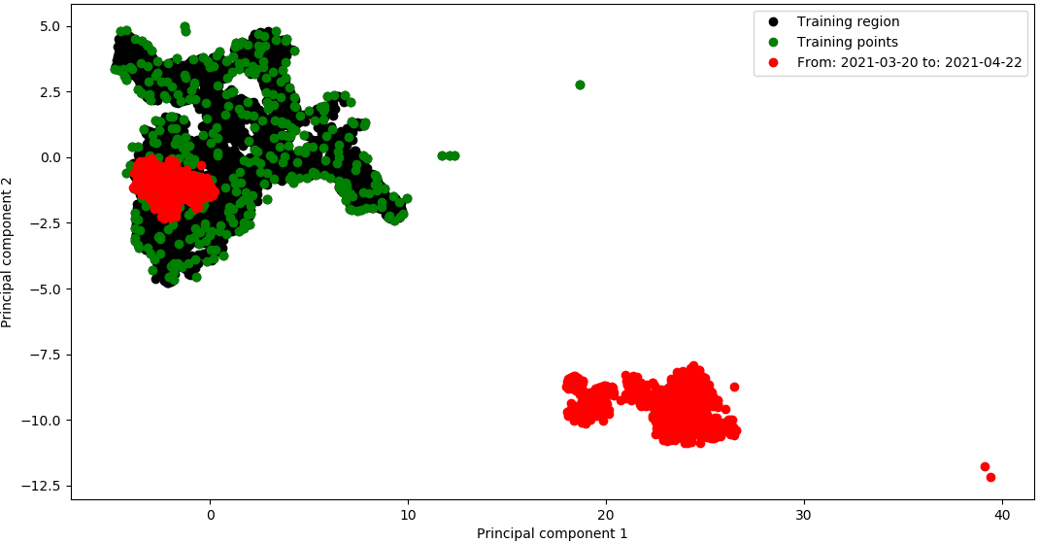
Test data: PCA tag data

Slide 30
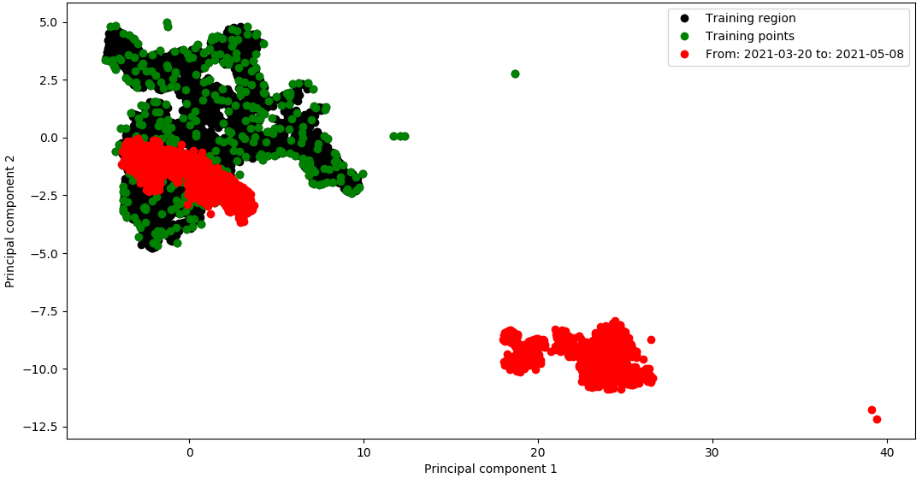
Test data: PCA tag data

Slide 31
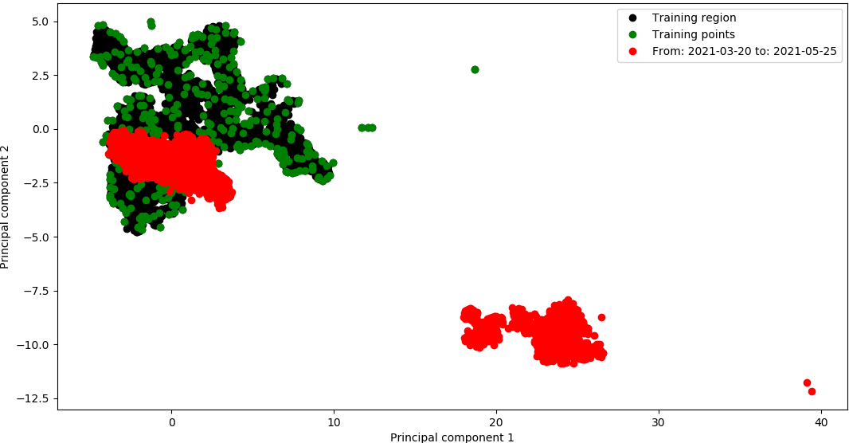
Test data: PCA tag data

Slide 32
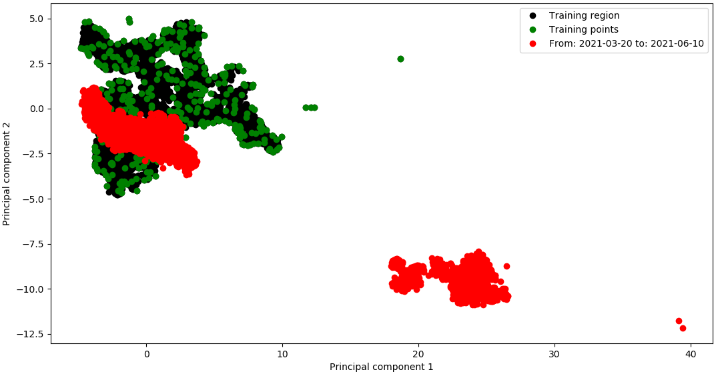
Test data: PCA tag data

Slide 33
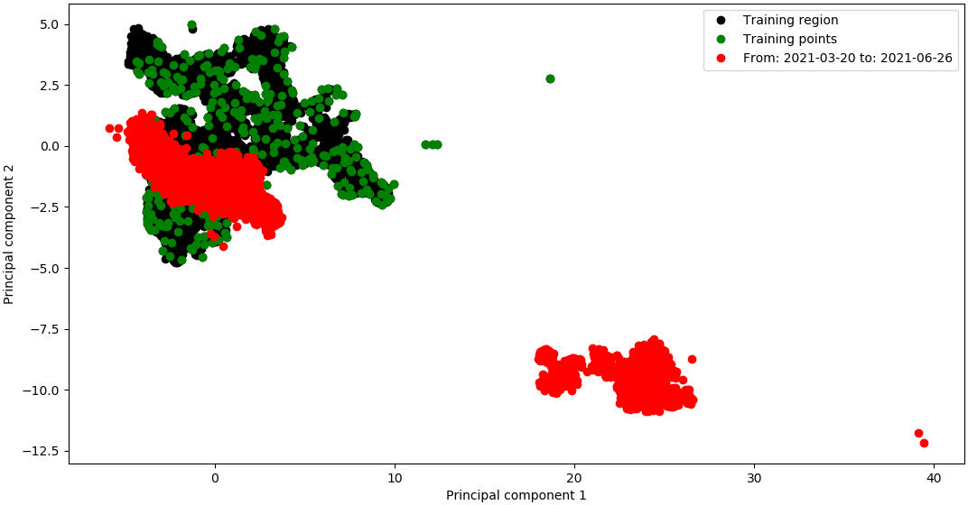
Test data: PCA tag data

Slide 34
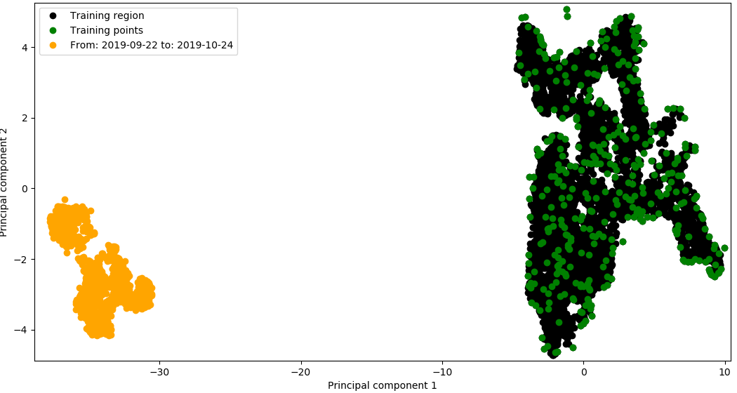
Previous training data: September - October 2019

Slide 35
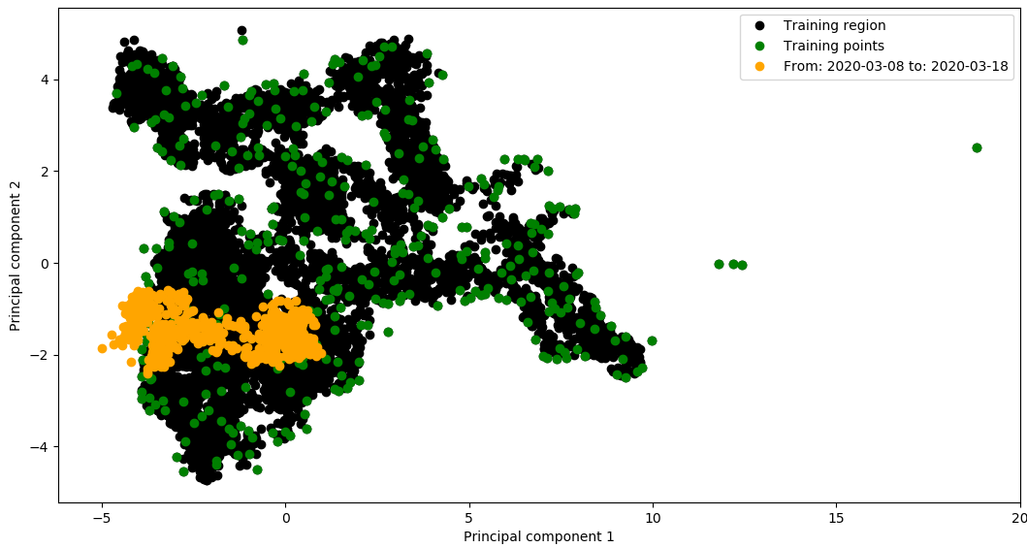
Previous training data: March 2020

Slide 36
Today
Content:
MK4 and ISRA-5D pipelines
List of inputs used in all the analysis
Updated plots: Regression using the training dataset
Test data: Fault scanner data and Tag data PCA plots
The Front wall temperature signals that we are averaging
Upskilling:
Linear regression
How do we learn ‘online’?
What actually is a Neural Network?
What is a Gaussian Process?
How does PCA work?
Shannon Entropy

Slide 37
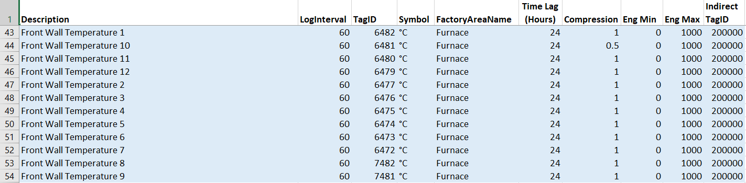
Front Wall Temperature

Slide 38
Next actitivies
Model predictions on the test data (MK4 and ISRA-5D): From 19/03/21 to 28/05/21
Comparison between the regression models
5 most relevant inputs (GP)
Second 5 relevant inputs (GP)
Important inputs identified with the Linear Regression model.
Implement an error measure.

Slide 39
Thank you for your attention. ANY QUESTIONS?

